Slide 1

JEDI Program
Course Registration System - Group 6

Slide 2
Where We Started ...
“Freshers appetite for expert knowledge”
Notes:
Yes Good morning all, First question to answer: Where we started ? So we started with a problem statement of Central Registration System, where we had many functionality like student can register, add/drop course, professors can view courses and enrolled students while admin can manage users, add/drop courses to catalog, we progressed by making UML artifacts i.e Use case Diagrams, Activity Diagram, Class and Sequence Diagram and then transforming these beautiful artifacts to code.

Slide 3
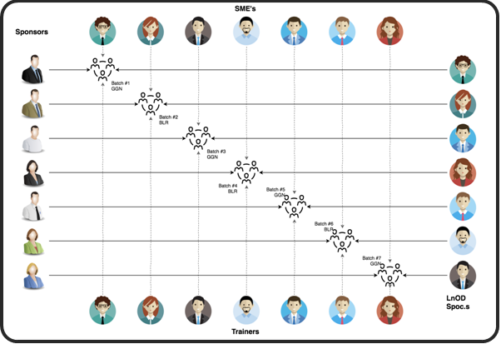
Stakeholders
Sponsor : Flipkart
SME : Amit Balyan
Other Coordinators : Deepika Gajaraj
Shree Lakshmi
Notes:
But before discussing about project we would like to thank Flipkart for this wonderful training program, Our Mentor Amit and our trainer Deepika and Shree.

Slide 4


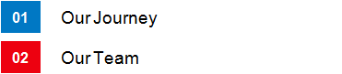
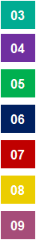







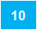

Agenda
Notes:
This is our Today’s agenda, a quick walkthrough:
First of all we’ll discuss our journey of building this Central Registration System, then a small intro of our fabulous team, after that we’ll talk about Project Goals, Engineering Practices, Tech stack and development, Challenges we faced and what we learned through that, and at last we’ll end our presentation by a Demo and Q&A. So I would welcome Raunkak to join and tell us about our journey.

Slide 5

Our Journey
Notes:
Hello Good morning all. Let’s start with our journey of how we developed the Central Registration System.

Slide 6
1.5 WEEKS OF TRAINING + PROJECT DEMO
13 DAYS
101 HOURS
6060 MINUTES
363600 SECONDS
LIMITLESS KNOWLEDGE

Slide 7
Action Plan
 | Modules | Description
Week 1 | UNIX GIT UML Diagrams | Understanding Unix and Git commands Requirement understanding & diagram design
Week 2 | Java 8 Exception Handling SQL Jersey & DropWizard | Developing a POS application using Java & MySQL Understanding Java 8 features and collections REST API development using Jersey and Drop Wizard framework

Slide 8
Demo
Mindset
Process
5
Project Demo
4
Adapting to a developer
Mindset
Tools
Comprehend
3
Design Thinking
2
Decide the Technologies JAVA/REST
1
Understanding Project Goals
Notes:
In this representation we have shown various stages during our journey.
It would cost more time and resources to identify and correct same error during later stages of development hence there is a need of proper development cycle.
The first stage of development for any successful application development is thoroughly understanding the problem statement, its feasibility and various in’s and out’s. Then we decided on technologies needed to incorporate the project requirements followed by its design. Once these fundamentals were laid then we moved to debugging, implementation and testing part.

Slide 9

Our Team

Slide 10



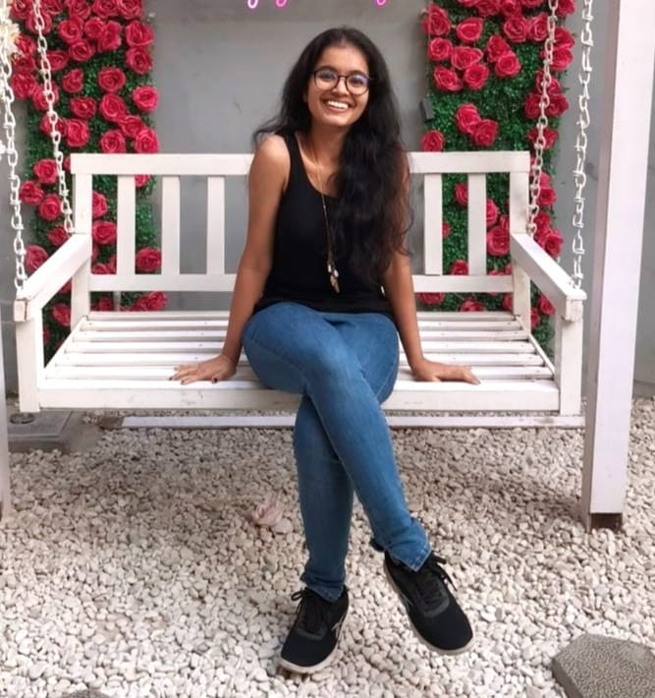

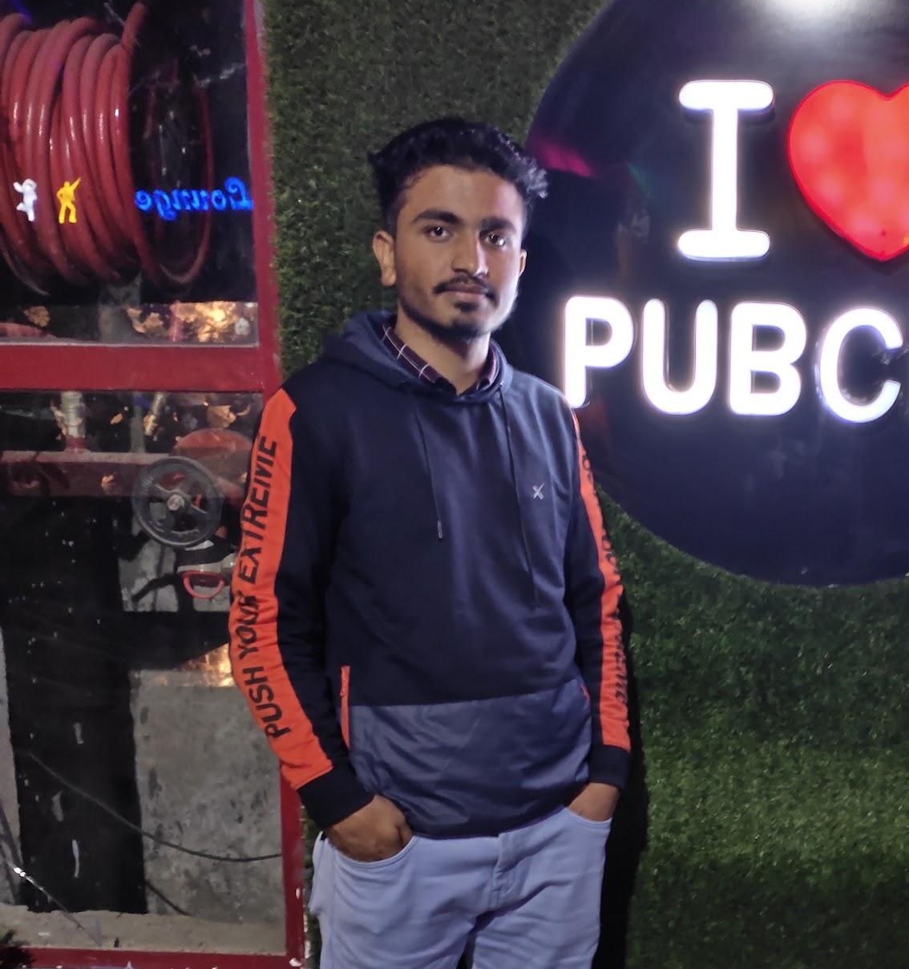

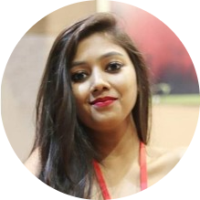
Jainam Sanghvi
(Group Leader)
Sneha Aggarwal
Aniket Modi
Devanshu Garg
v
Saksham Varshney
Shubham Khandelwal
Raunak Bhandari
Shambhavi Sahay

Slide 11

Project Goals

Slide 12

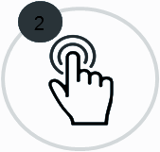
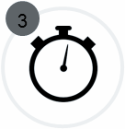

Vision
To develop a POS application and REST API for Course Registration System using JAVA where the student can register, add/drop course, professors can view courses, enrolled students while admin can manage users, add/drop courses to catalog.
4
Quality
Speed
Interactivity
Security

Slide 13
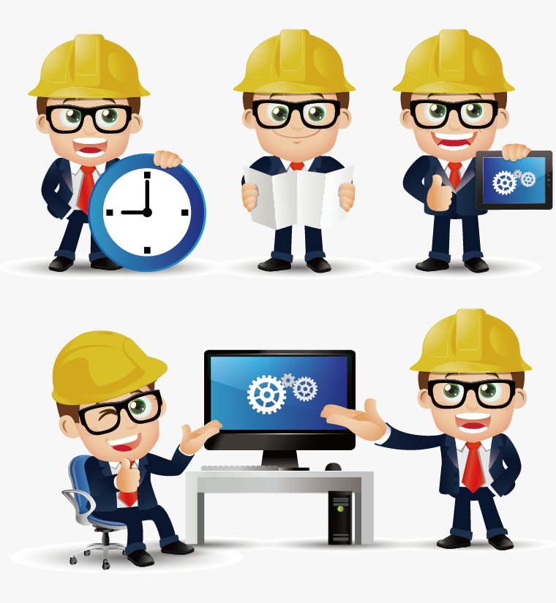
Engineering Practices
Notes:
Time – 5 mins

Slide 14
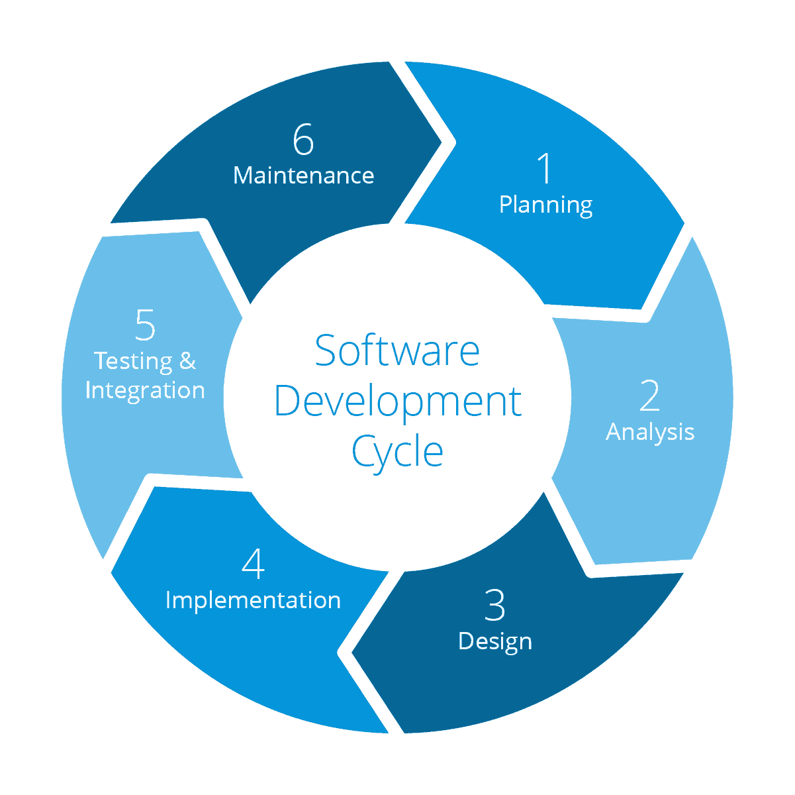
Requirement gathering
System Testing
Technology stack selection
Code implementation and development
UML artifacts design

Slide 15
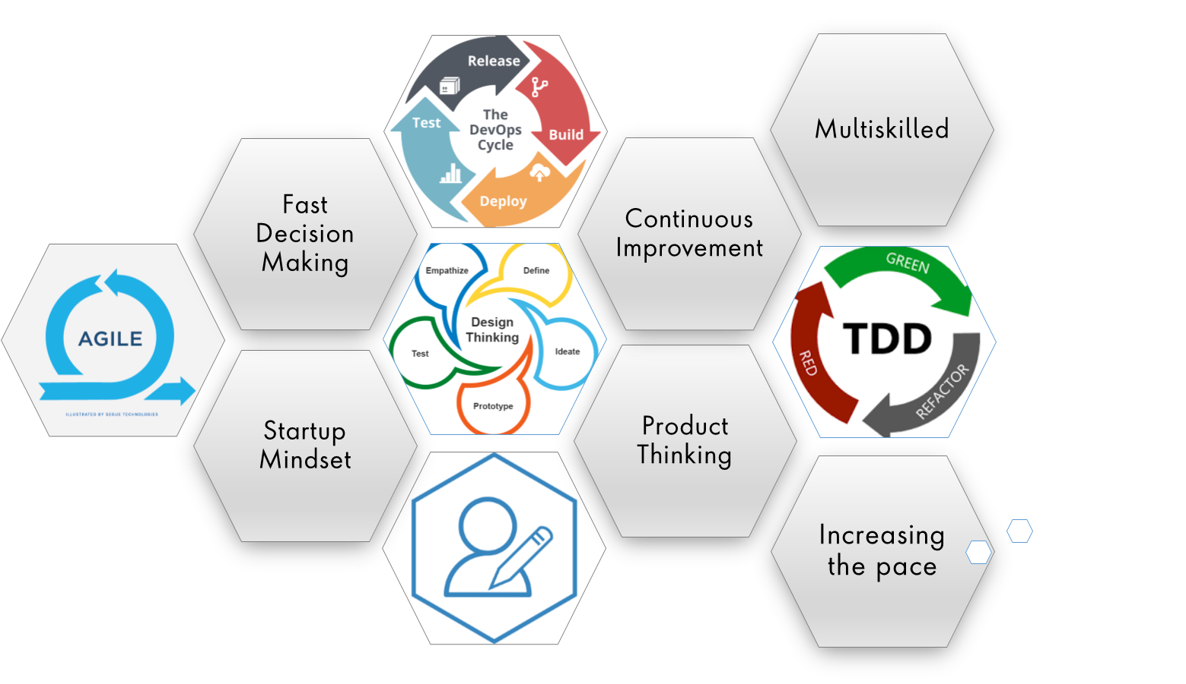
Notes:
Product Thinking (Design Thinking, Requirement Analysis, )
Multi Skilled (Frontend, Backend, DevOps)
Fast Decision Making (Agile)
Increasing the Pace (Automation CI/CD)
Startup Mindset (Agile)
Continuous Improvement (Retros)

Slide 16
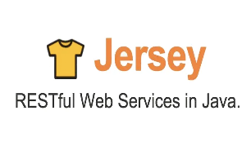

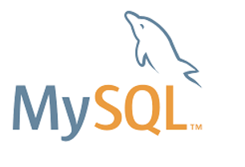

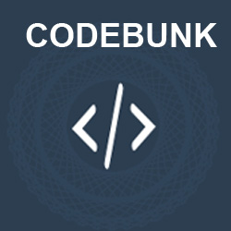

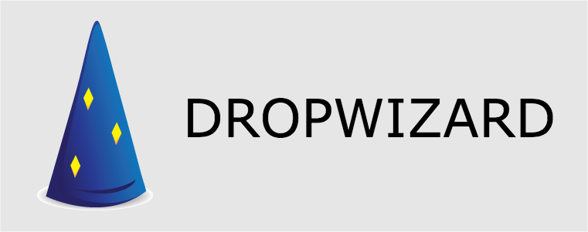


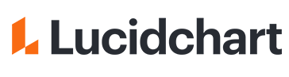
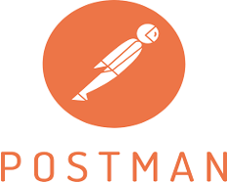



Tech Stack
Core Language
SQL Database
Code Collaboration
Application Server
API Client
Diagramming Application
IDE
Notes:
-RESTful web services are services that are built to work best on the web. Representational State Transfer (REST) is an architectural style.
-Jersey RESTful Web Services 2. x framework is open source, framework for developing RESTful Web Services in Java that provides support for JAX-RS APIs and serves as a JAX-RS.
-Dropwizard pulls together stable, mature libraries from the Java ecosystem into a simple, lightweight package that lets you focus on getting things done.
Dropwizard is an open-source Java framework used for the fast development of high-performance RESTful web services
Essentially it's an open-source Java servlet and Java Server Page container that lets developers implement an array of enterprise Java applications. Tomcat also runs a HTTP web server environment in which Java code can run
Postman is an interactive and automatic tool for verifying the APIs of your project. ... It works on the backend, and makes sure that each API is working as intended
-MySq:l MySQL is a relational database management system based on SQL – Structured Query Language. The application is used for a wide range of purposes, including data warehousing, e-commerce, and logging applications
-Lucidchart Create flowcharts & diagrams online. It heled us to visualize our ideas faster, clearer and more collaboratively.
-for version control we used git. Github is a web-based platform used for version control. Git simplifies the process of working with other people and makes it easy to collaborate on projects.

Slide 17

UML Diagrams
UML (Unified Modelling Language) is for visualizing, specifying, constructing and documenting the components of software and non-software systems
UML diagrams undertaken in this project: 1. Use Case diagram 2. Activity diagram
3. Sequence diagram
4. Class diagram

Slide 18

Development

Slide 19
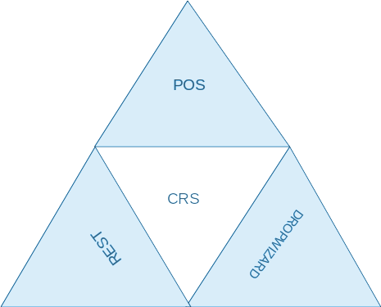
Feasibility Study
Meetings
Tests
Requirement understanding
Research and analysis
Estimation
Sprint Planning
Spring Grooming
Delivery
Sprint Implementation
Development
Code Review
Commit
Integrate
Deploy
Test
Notes:
Next let’s look at the flow of project.
The project consisted of three major milestones, firstly a POS (Point of Sales Application) which was based on Core Java Standard Edition(JSE). The POS application incorporated strong Object Oriented Programming and OOAD principles.
The second application was based on Java Enterprise Edition(JEE) where we developed a restful web API using Apache Jersey.
For the final application we developed a DropWizard Rest API using Maven JAVA project on top of Jersey.
We will have a more deeper dive into project technologies later during the presentation.
Now I would welcome XYZ to take the presentation further.

Slide 20

Architectural Design

Slide 21
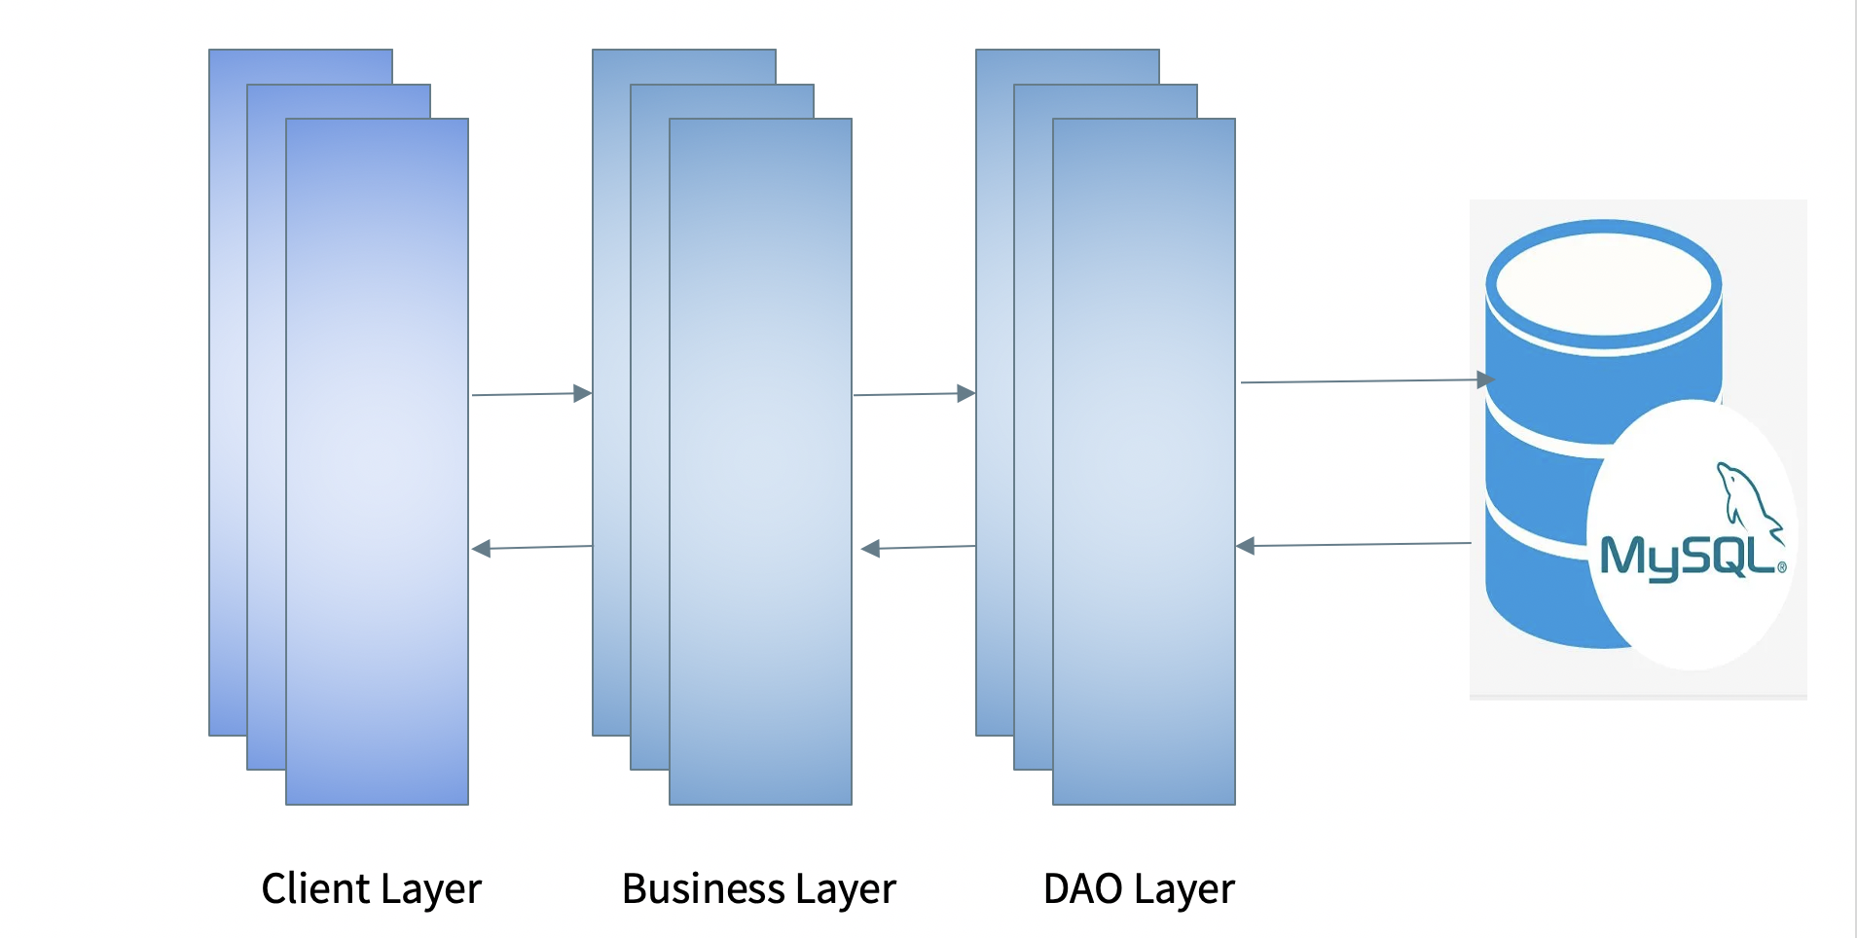
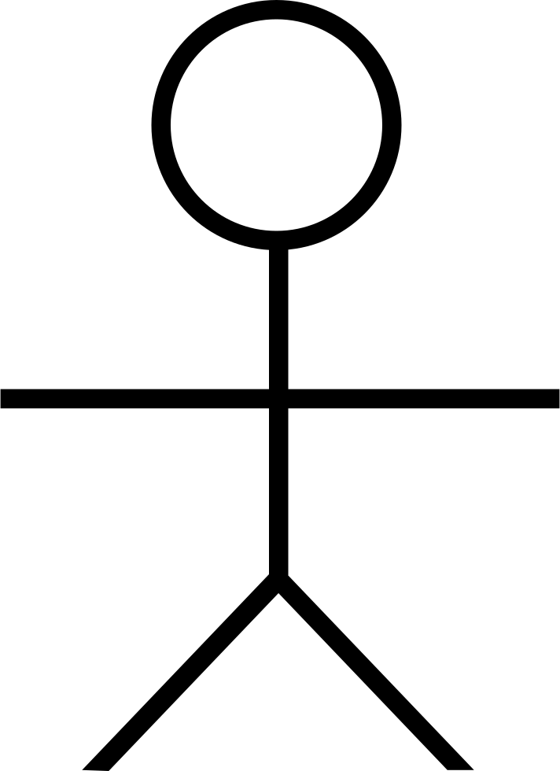
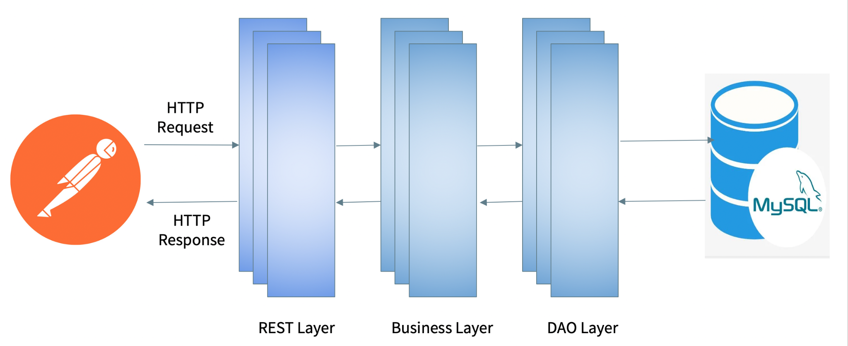
System Architecture: Console Application
Input
Output
User

Slide 22

CRS Demo

Slide 23
POS - Console Based Application

Slide 24
What is a ‘Console-Based’ Application? -Runs on console of IDE.
User
Input
Console
Output in the form of console messages
Local Database Used: MYSQL. Logging libraries used: Log4j
Notes:
THank you jainam for telling us about the console allocations and its layers. But what really is a console based application. A Console Based application run on console of ide which gives us messages with print statement and takes input from user based on requirement and then display the desired result. 2. In this we gradually designed our application based on problem statement and then connect it to local database. In our case we have used MYSQL. 3. For logging Log4j library has been used to keep record of information and error.

Slide 25
Following is the POS project structure:
Application: Main class and menu of the each role.
Beans: All the attributes of class table in database and their getter and setter methods.
Business: Defined logics and functionality need to perform based on user input.
Constants: Defined the value of some variables which we are using frequently like sql queries.
Dao: Present logics for performing sql operations called by services
Exceptions: User defined exceptions classes are present here.
Utils: For structures and connectivity classes.
Notes:
4. Following is the POS project structure: a. Application: Main class and menu of the each role. b. Beans: All the attributes of class table in database and their getter and setter methods. c. Business: Defined logics and functionality need to perform based on user input. All logic which is tied to the web application functionality is located in this layer. d. Constants: Defined the value of some variables which we are using frequently like sql queries. e. Dao: Present logics for performing sql operations called by services f. Exceptions: User defined exceptions classes are present here. g. Utils: For structures and connectivity classes

Slide 26
REST API and Dropwizard

Slide 27
REST APIs
What is REST? -REST stands for REpresentational State Transfer. -A RESTful API follows the REST architectural constraints
What are the advantages of REST? faster, scalable APIs that support all data types. RESTful APIs are flexible and versatile.
Server used: Apache Tomcat 8.5 server Testing Application: POSTMAN. APIs used: JAX-RS API RESTful Web Services framework used: Jersey
Notes:
JAX-RS API - a Java programming language API designed to make it easy to develop applications that use the REST architecture. We used Jersey to implement JAX-RS. Jersey - for developing RESTful Web Services in Java that provides support for JAX-RS APIs.

Slide 28
System Architecture: REST API

Slide 29
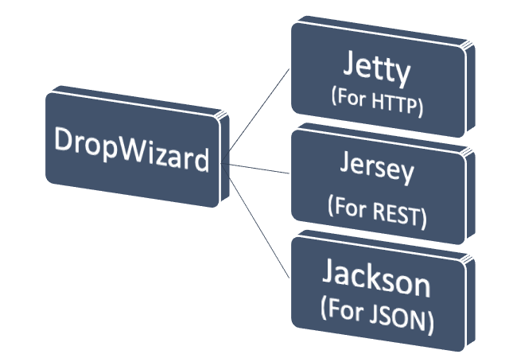
Dropwizard
Dropwizard is a Java framework for developing ops-friendly, high-performance, RESTful web services.
We converted Jersey REST Apis into Dropwizard Apis and ran APIs on server provided by Dropwizard.

Slide 30

Challenges & Learnings
Notes:
Time – 2 mins
Challenges-
Installing the Tomcat server and running application on it.
Learnings-
Got to learn new technologies.
Learnt working together in teams.(collaboration)
Learnt how to write code which is accepted by the industry.
Learnt how to make UML diagrams for the given problem.

Slide 31
Challenges
Installation Issues
Working at odd hours
Working in team virtually
Migration from one tech stack to another
Resolving jar & virtual dependencies
Database Integration Challenges
Notes:
Installing the Tomcat server and running application on it.
Setting up the dropwizard project.
Making connection and debugging the code.
Collaboration issues such as merge conflicts in Git

Slide 32
Learnings
Java Backend Development
Got familiarized with UNIX commands
LifeCycle of a project
Real time project experience
Team work
Developer way of thinking
Postman client to test API’s
Integration of REST Services with JAVA code using Tomcat and Jersey

Slide 33

Questions

Slide 34
Thank you!

